Slide 1

Maths at Kemsley
Information for Parents and Carers

Slide 2
In today’s session:
Context
Mastery approach
CPA approach
White Rose lesson example

Slide 3
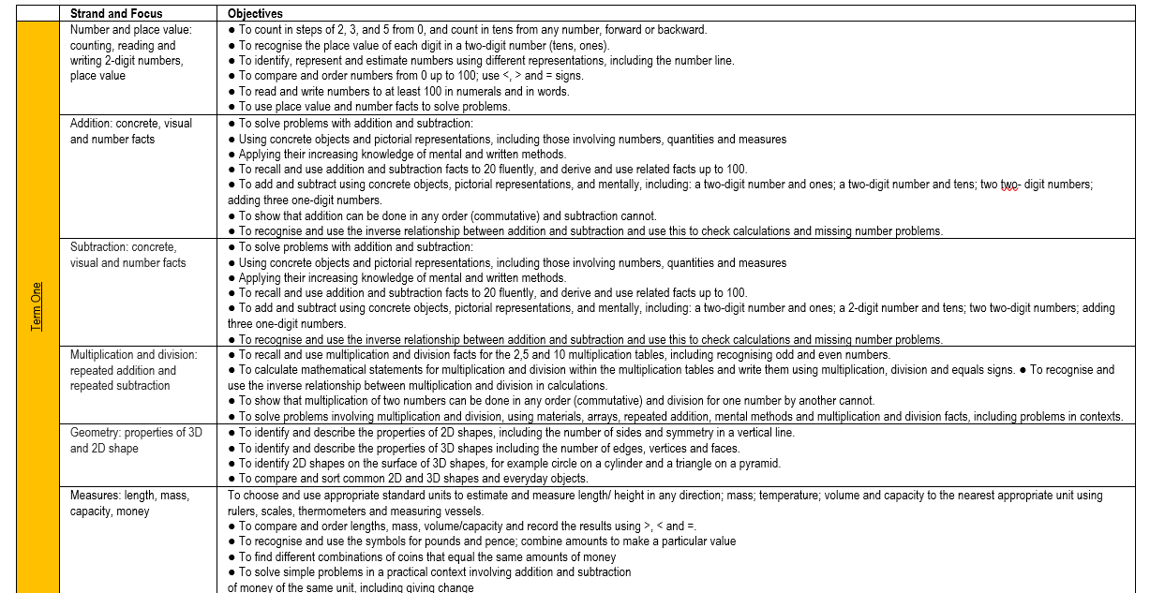
Context
Prior to September 2022, Kemsley had a set of strand coverage documents for years 1-6.
-There were often too many objectives to fit into one week.
-The objectives were repeated multiple times over the course of the year.
-No slides or resources.
-EYFS used a different scheme of work.

Slide 4
Mastery Approach
White Rose Maths is an organisation that provides maths resources and Schemes of Learning for pupils of all ages, from early years to secondary school.
White Rose uses a maths mastery approach.
This involves breaking down larger, complex learning goals into smaller steps.
A pupil is said to have mastered a mathematical concept when they can display that concept in multiple different ways and apply that concept to a new problem which they are unfamiliar with.
Ultimately, maths mastery focuses on depth over speed. Pupils are encouraged to demonstrate a deep understanding of mathematical concepts, slowly building their knowledge over time.
Teaching maths for mastery involves whole-class interactive teaching — all pupils working together.

Slide 5
The maths mastery approach has these values at its heart:
Success in mathematics for every child is possible
Mathematical ability is not innate
Focus on fewer topics, covered in more depth
Mastery for all pupils, with full understanding
Number sense and place value come first
Problem solving is central to all learning

Slide 6
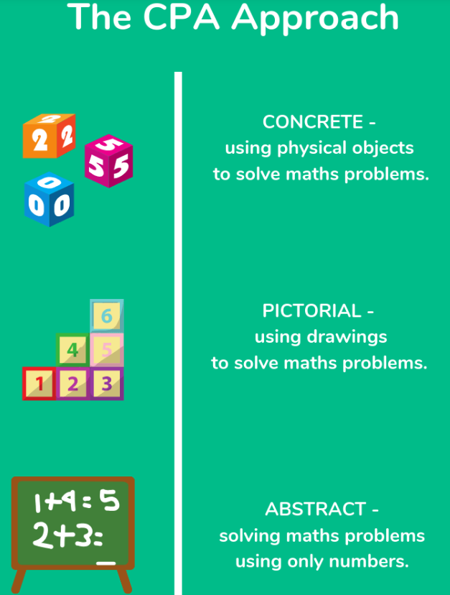
CPA
The concrete > pictorial > abstract approach is the basis of the teaching.
Concrete: Pupils are encouraged to use concrete objects to symbolise mathematical concepts.
Pictorial: Pupils build on their concrete understanding by using illustration, using imagery to reinforce and deepen their understanding.
Abstract: This foundational work allows pupils to embrace key mathematical concepts on an abstract level. This is where they are able to master the concept.

Slide 7
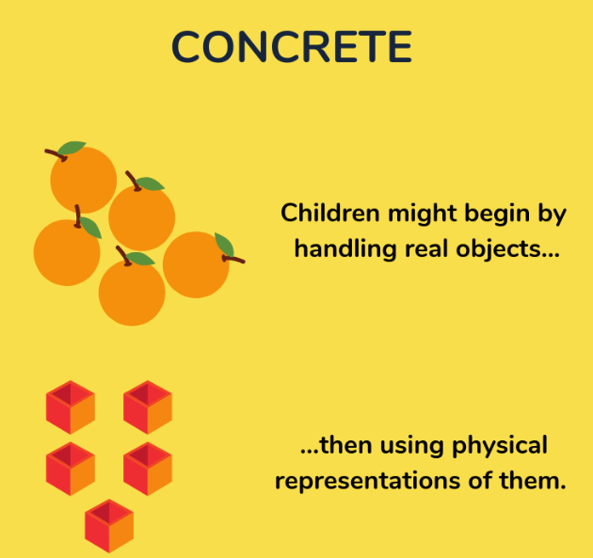
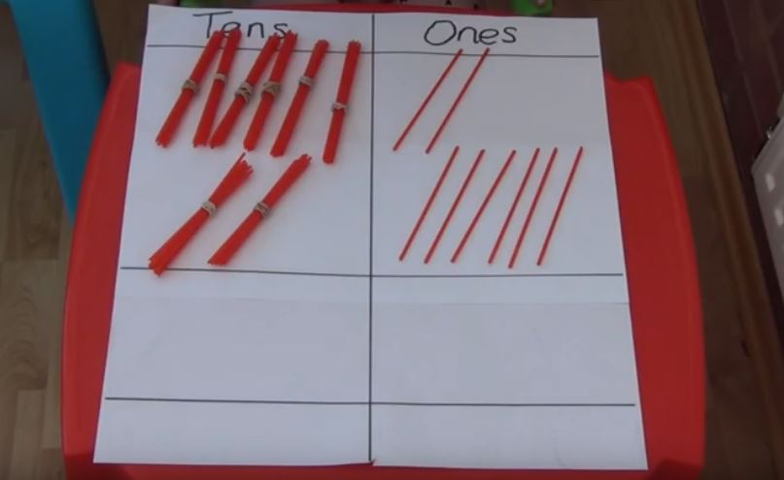
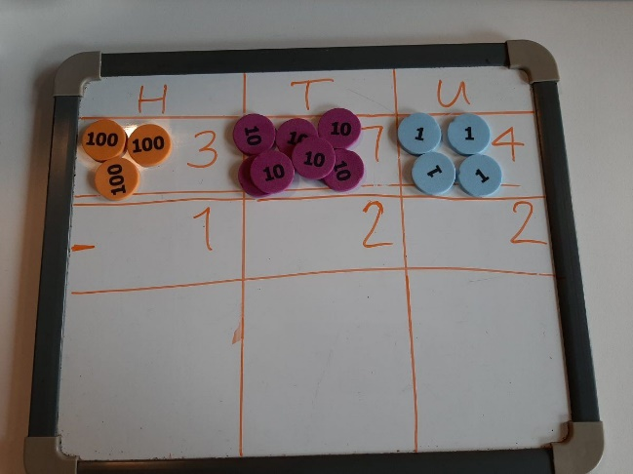
What is a ‘Concrete’ representation in the CPA approach?
As part of the CPA approach, new concepts are introduced through the use of physical objects or practical equipment. These can be physically handled, enabling children to explore different mathematical concepts. These are sometimes referred to as maths manipulatives and can include ordinary household items such as straws or dice, or specific mathematical resources such as dienes or numicon.
The abstract nature of maths can be confusing for children, but through the use of concrete materials they are able to ‘see’ and make sense of what is actually happening. Previously, there has been the misconception that concrete resources are only for learners who find maths difficult. In fact concrete resources can be used in a great variety of ways at every level. All children, regardless of ability, benefit from the use of practical resources in ensuring understanding goes beyond the learning of a procedure.
Practical resources promote reasoning and discussion, enabling children to articulate and explain a concept. Teachers are also able to observe the children to gain a greater understanding of where misconceptions lie and to establish the depth of their understanding.

Slide 8
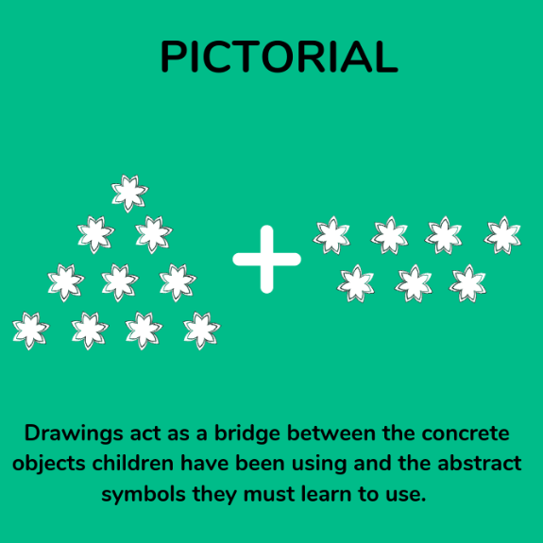
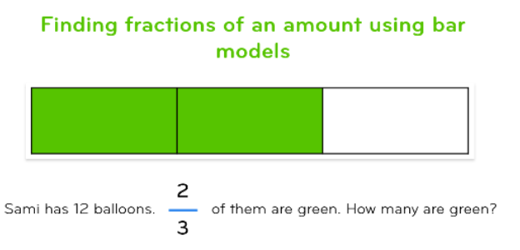
What is a ‘Pictorial’ representation in the CPA approach?
Once children are confident with a concept using concrete resources, they progress to drawing pictorial representations or quick sketches of the objects. By doing this, they are no longer manipulating the physical resources, but still benefit from the visual support the resources provide.
One of the most common methods of representing the pictorial stage is through the bar model, which is often used in more complex multi step problem solving.

Slide 9
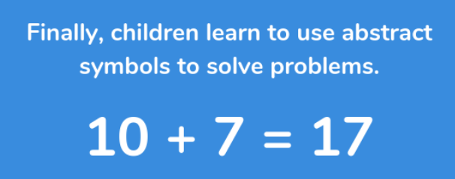
What is an ‘Abstract’ representation in the CPA approach?
Once children have a secure understanding of the concept through the use of concrete resources and visual images, they are then able to move on to the abstract stage. Here, children are using abstract symbols to model problems – usually numerals. To be able to access this stage effectively, children need access to the previous two stages alongside it.
For the most effective learning to take place, children need to go back and forth between each of the stages. This ensures concepts are reinforced and understood.

Slide 10
Benefits of a maths mastery approach:
Pupils are required to think more deeply about mathematical concepts.
A slower pace leads to greater progress because it ensures children secure their understanding.
Children are given time to really understand concepts at a deeper level, rather than surface-level learning a set of rules.
Smaller steps lead to children not becoming overwhelmed too fast.
Useful resources:
https://masterthecurriculum.co.uk – What is maths mastery?
https://blog.hope-education.co.uk – What is maths mastery?
https://www.trueeducationpartnerships.com – What is the maths mastery approach?

Slide 11
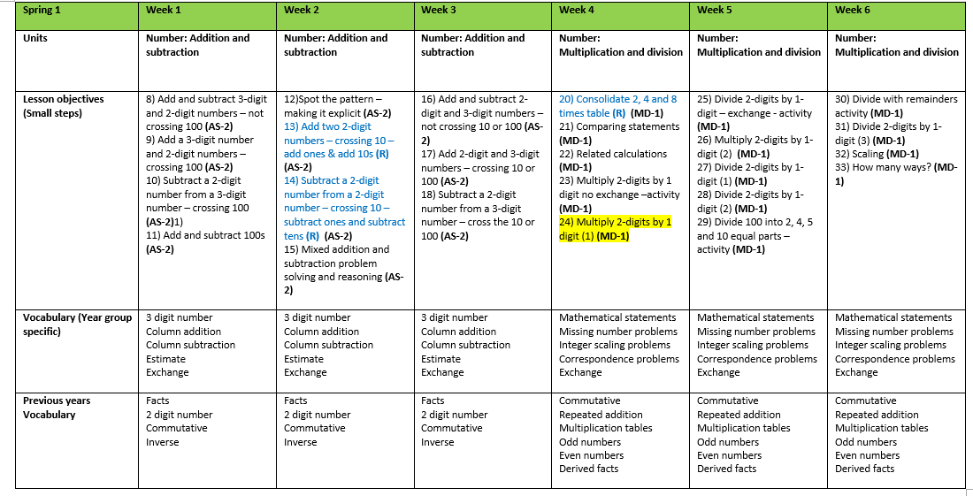
White Rose package – Year 3 example

Slide 12

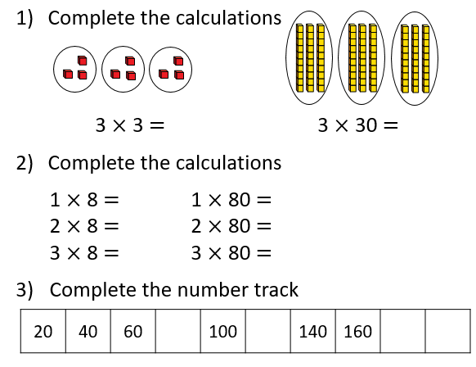
1. Reactivate
Allows children to make links with prior learning.
Notes:
Reiterate the purpose of this and emphasis the need for children to be aware of why they do it, how it helps them
Reference working wall when doing it
Think about how it is carried out. Year 1/2 – On carpet with white boards, or together as a class (chanting, with their partner). Every question one-by-one and children talk to partner before answering. Run through answers quickly. Year 3 (KS2) – in books, self-assessed

Slide 13
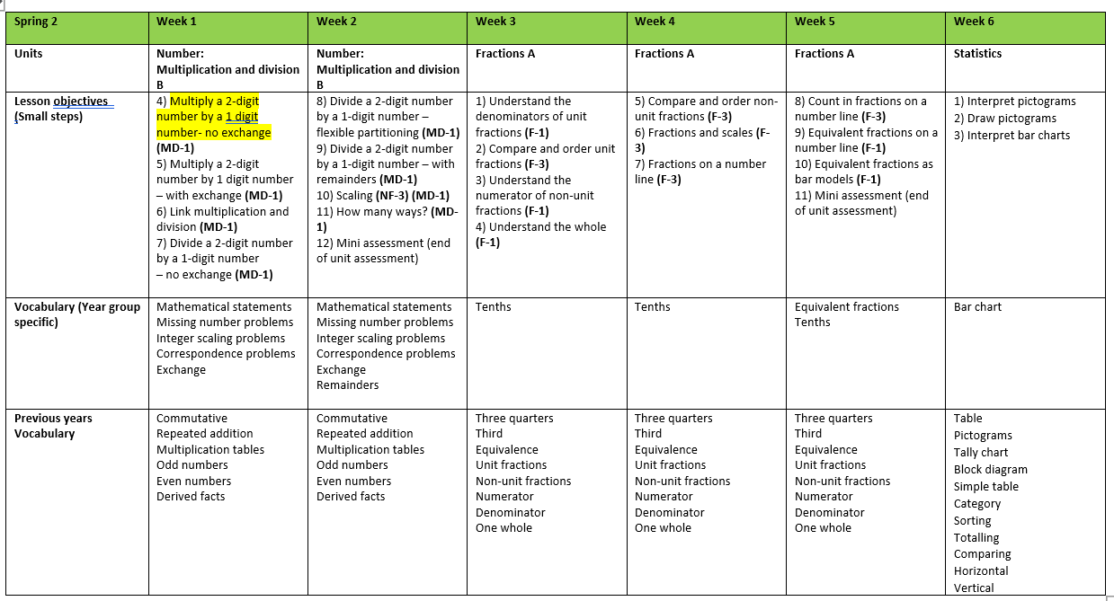
2.TBAT: Multiply 2-digits by 1-digit
and Success Criteria
3.Vocabulary

Slide 14

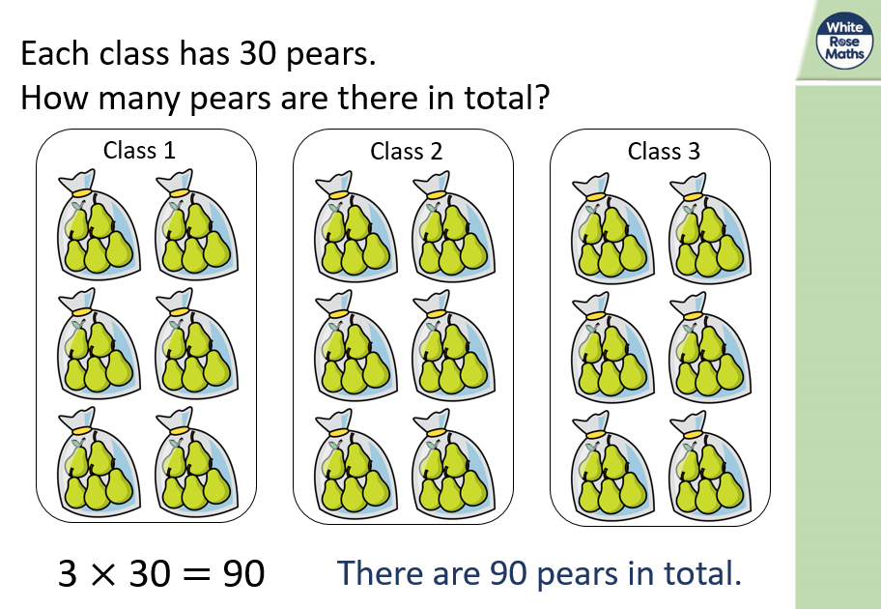
4. ‘Lets Learn’
  During this section:
  Teachers will circulate the room.
  Look at how the children are working through the problem.
  Assess and listen to who may need more support and identify who needs more challenge.
  Encourage children to use mathematical vocabulary.
Notes:
Where there are other slides emphasise or remodel to quickly work through and ask questions as you go/ do collectively/ talk to your partner
Additional adult could be sat at a table with focus children modelling alongside the teacher onto a white board, showing how resources can be used, creating a step by step guide for children, using questioning to clarify,

Slide 15
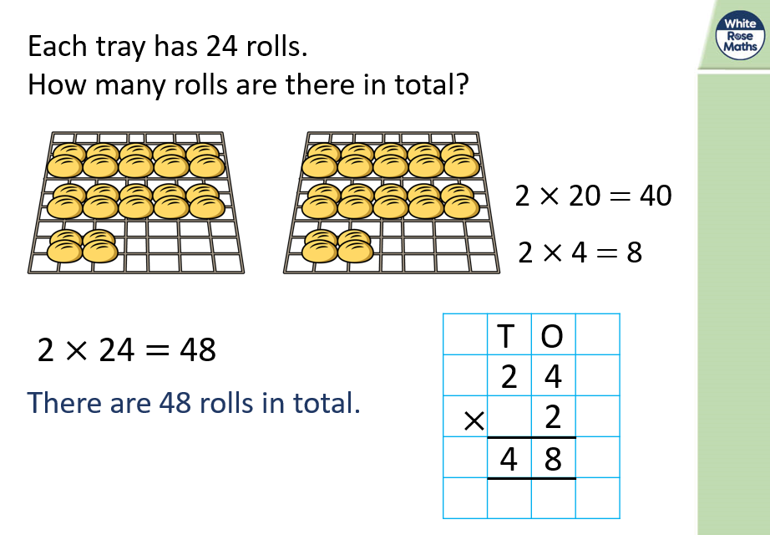
Teachers work through the slides modelling the strategy
This first slide shows the use of the standard method without resources, next slide shows the relationship between the resources and the abstract procedure
Teachers use the paper flip chart so it can be displayed on the working wall for children to reference.

Slide 16
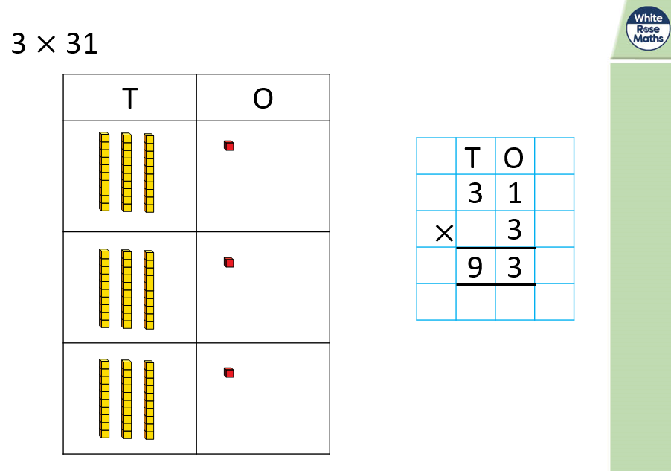
Resources and pictorials are modelled alongside the abstract strategy.
Children should have access to resources during this period so they can follow along.
Teachers articulate their thought process out loud as they work through the strategy.

Slide 17
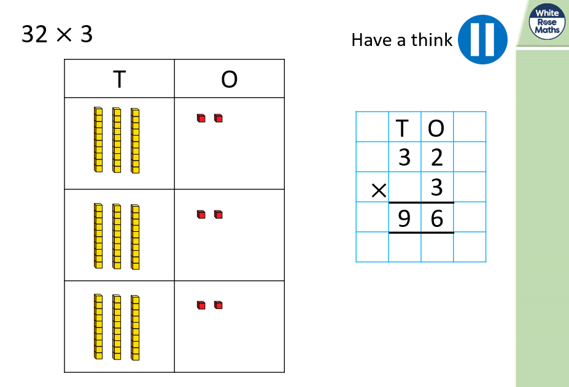
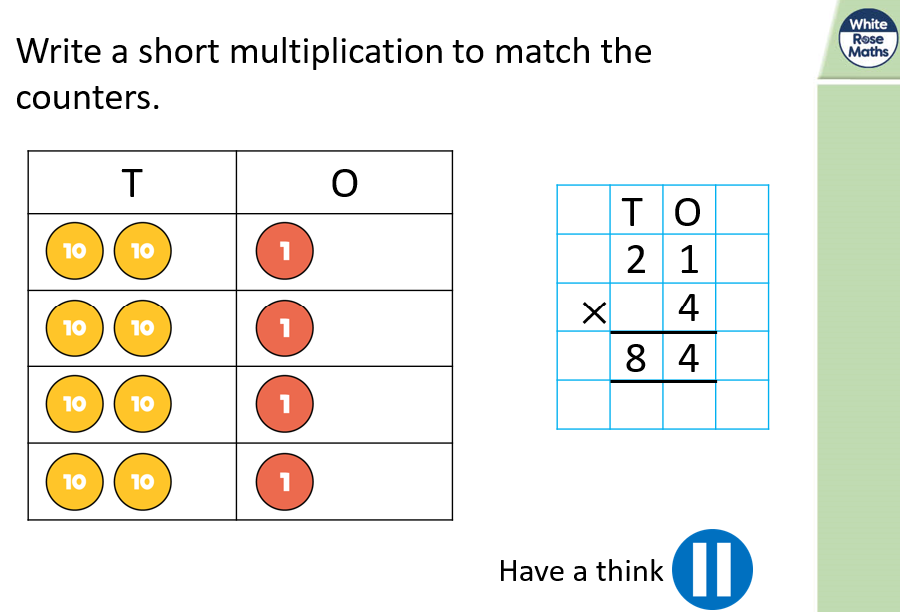
Our Turn
This is a key assessment point to see if children are ready to access independent work.

Slide 18
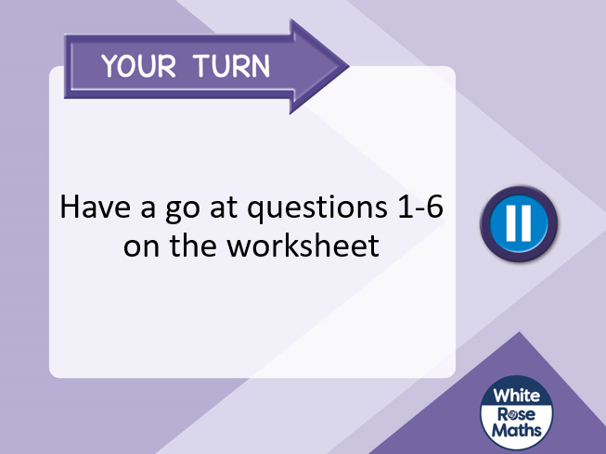
Children independently work through the questions outlined on the slides.
These fluency questions are designed to check that the children can demonstrate knowledge of skills the teacher has modelled.
Marking in the moment is used during this period to identify if additional modelling is required for a focus group or to identify those who can move on to the reasoning and problem solving questions.
Notes:
This is a key assessment point
Use the slides or create a question based on what you’ve modelled for children to try
This can be done on whiteboards, in books, physically with a partner.
The key point here is that you set children off and use this as an assessment point to see if children are ready to access independent work
They can show whiteboards, you can buzz around marking, you can share the answer and they can give you a thumbs up
This should show you whether they may need additional modelling of the first question for instance, or they may need more support from a T.A
Role of teacher and support staff
If there are any slide afterward you may wish to quickly go through them

Slide 19
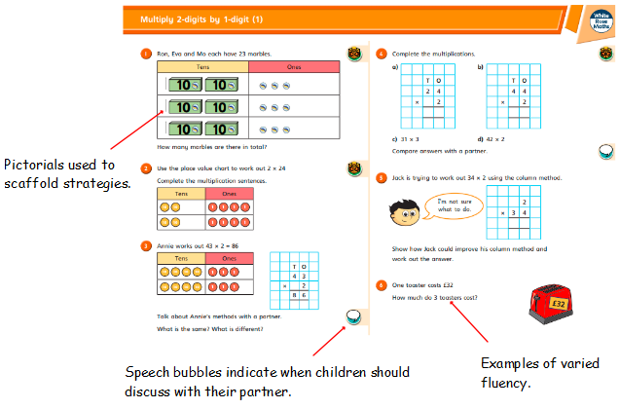
Worksheet – Varied fluency practice
Uni link cubes indicate where resources can be utilised

Slide 20
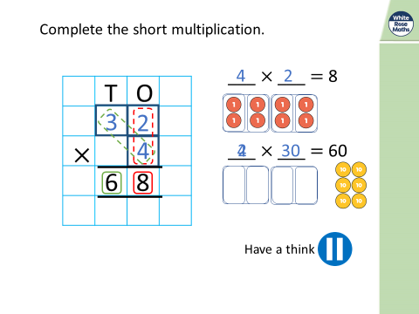
Additional modelling for the whole class or specific groups so they can access the reasoning and problem solving questions.
Teachers work through the modelling before setting children off again.

Slide 21
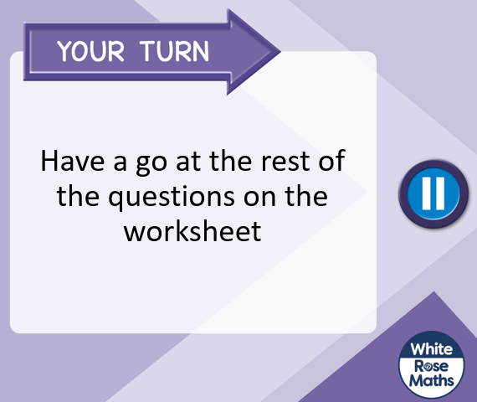
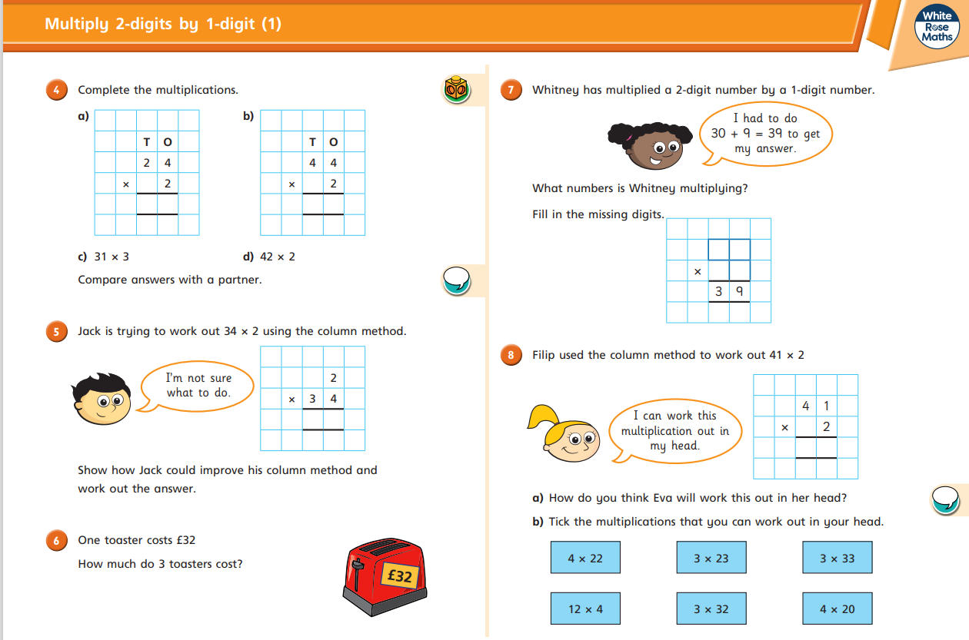
Children complete the rest of work sheet (reasoning and problem solving).
Supplement these tasks with other resources if necessary.
Children are moved onto reasoning and problem solving when they are ready.

Slide 22
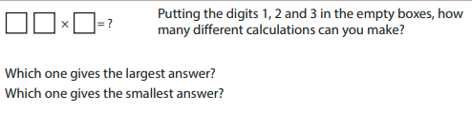
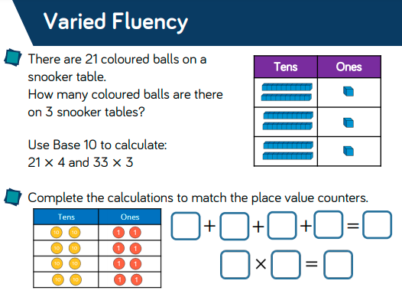
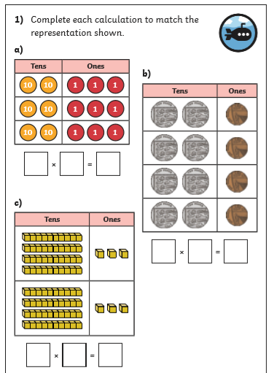
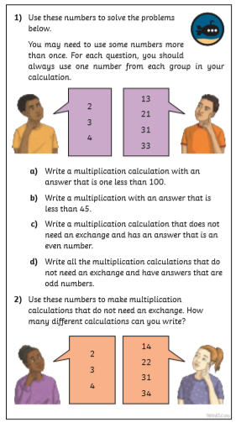
Examples of other resources that are used in lessons.
These could be used to add additional fluency, stretch more able children and to provide opportunities to use and apply skills.
NCETM – Teaching For Mastery
White Rose – Schemes of Learning
TWINKLE – Diving into Mastery
Notes:
Example of other resources that can be used to supplement the premium resources
These could be used to add additional fluency, stretch more able children and to provide opportunities to use and apply skills
Relatively easy to find supplementing resources as diving into mastery are linked to White Rose as are classroom secrets.

Slide 23
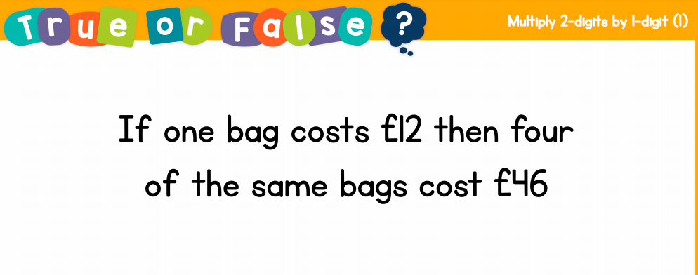
5. Plenary
Children are encouraged to explain or write a set of instructions for a strategy they have used.
The teacher may revisit the question from the beginning and ask children to explain the process they would now go through.
Adults may assess individual and collective learning using thumbs up/thumbs down etc.
Revisit a question children have struggled with during the lesson and go through it together.
Complete a True or False question.

